Slide 1
Stock Price Manipulation Detection using Generative Adversarial Networks
Presented by Team 2

Slide 2
Introduction
Market has bad players who gain profit by deceiving other players through market manipulations. The field faces 3 challenges:
1. Distinguishing manipulations from normal trading behaviours.
2. The small amount of damage from a few easy-to-expose manipulations.
3. The data is partially observable, due to buyers/sellers privacy.
Proposed solution: train deep neural network, since manipulation cases are irregular trading behaviours and it can learn without labels.

Slide 3
Related Work
The related research focuses on trade-based manipulations that studied theoretical and empirical work:
Large investors have large probability to take part in stock manipulation.
An investor who has insider information of a firm also has high probability to be a manipulator.
Manipulator may gain his profit by making takeover bid for stock price manipulation (sell the stock at the expected price).
Liquidity, returns, and volatility affected the stock price during manipulation periods, where stocks with low volatility and value had high chances to be manipulated.
Examples of used machine learning techniques and other methods:
Data mining techniques vs. logistic regression and discriminant analysis → data mining performed better.
K-nearest neighbour vs. adaptive dynamic model → both performed well.

Slide 4
Stock Manipulation Patterns
Illegal strategies to influence stock prices for personal gain.
Examples: Information-based, Action-based, and Trade-based.
'Pump-And-Dump': Inflating stock prices through misleading positive statements, then selling off once the price is high.
Variables involved in stock price manipulations: Cancelled volumes and matched volumes.
Impact: Distorts market integrity, misleading investors, and affecting market stability.

Slide 5
Anomaly Detection using GANs
GAN Framework
Discriminator
LSTM Integration
Anomaly Identification
Generator
Advantages
Utilizes two neural networks, a Generator and a Discriminator, in a competitive setup.
Learns to differentiate between real and generated data.
Incorporates Long Short-Term Memory networks to effectively process time-series data.
Creates synthetic data mimicking real stock trading patterns.
Anomalies in stock data are treated as 'generated' data, revealing manipulation patterns.
Enhanced detection capabilities, adapting to evolving manipulation techniques.
Notes:
Let’s consider models used in the article. GAN Framework utilizes two neural networks, a Generator and a Discriminator, in a competitive setup. Generator creates synthetic data mimicking real stock trading patterns, while Discriminator learns to differentiate between real data and market manipulations. Both machines try to fine-tune their parameters and become better in their capabilities. Although each player depends on each other, each player cannot control the other’s parameters.
An LSTM network is a type of RNNs, which takes their outputs from the previous time step to be fed into inputs of the next time step. The main idea of LSTM is to learn what to forget and what to remember.

Slide 6
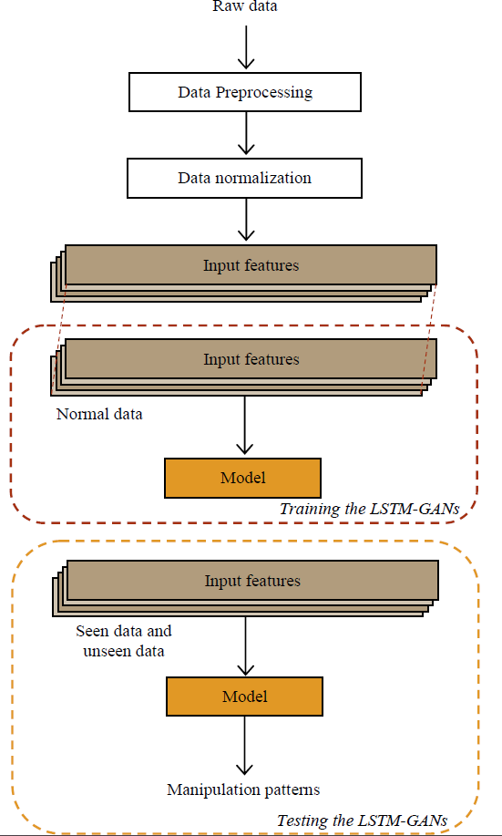
Models
Architecture: Combines GANs with LSTM networks.
LSTM Usage: Processes time-series data, essential for analysing stock market trends.
Generator Model: Creates data sequences simulating potential manipulation patterns.
Discriminator Model: Distinguishes between actual market data and generated sequences.
Training Process: Iterative adjustment of both models to improve detection accuracy.
Objective: To effectively identify subtle and complex manipulation tactics in stock market data.
Notes:
The model used in the research combines GANs architecture with LSTM networks. LSTM effectively processes time-series, which is essential for analysing stock market trends. And constant cross-improvement of generator and discriminator ensures successful anomalies detection. The main objective of the model is to identify subtle and complex manipulation tactics in stock market data.

Slide 7
Experiments data
Unable to get enough real data, the authors switched to injecting synthetic manipulation patterns to the real dataset, which isn’t available today.
Paper’s data: 22 full trading days of the biggest companies, with no reported market manipulations.
Our data: Bitcoin Dataset – midpoint, spread, amount sold, cancelled amounts, best bid price and best ask price.
The authors focus on the format of data called limit order book (LOB). The LOB tables were set in five depths with single second sampling period.

Slide 8
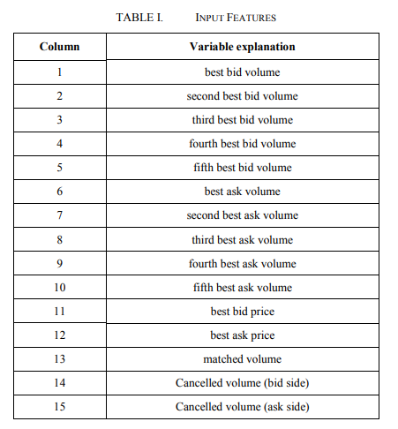
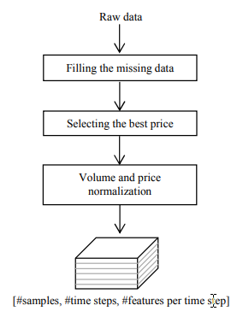
Notes:
Here are features used in original research as model input (on the left) and pipeline of data normalisation process (on the right)

Slide 9
Experiments
The LSTM-GANs were trained on sequential data.
A random noise was then fed to a dense layer and the LSTM layers of the generator.
This outputted a sequence which tried to mimic the original time-series.
The data was then reshaped and entered into the discriminator for the classification task.
The output from the discriminator was ‘1’ for real and ‘0’ for generated data.
The authors proposed a manipulation scheme that lasted for 5 seconds.
Pumping period: first four seconds,
Dumping period: one second.
Constant rate for bid and ask: 0.1% per second during the pumping period.
In the dumping period, the bid orders were cancelled, and the ask orders were quickly executed.

Slide 10
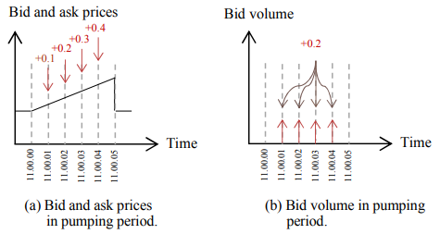
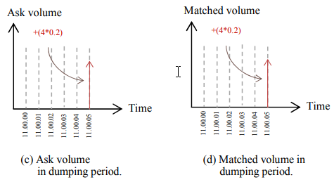
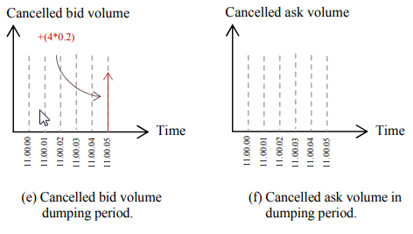
Notes:
Here are the graphics describing how different variables change during simulated market manipulation.

Slide 11
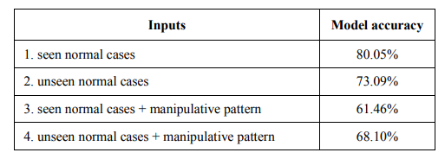
Experiments results

Slide 12
Conclusion
The authors’ experiment showed that the LSTM-GANs were effective for detecting stock price manipulations. The model performed well with both seen and unseen data. This is the first research to apply deep generative adversarial networks on the problem of detecting stock price manipulations.
Contributions of the paper:
The paper proposed an unsupervised methodology employing a combination of LSTM and GANs for stock price manipulation detection.
The proposed LSTM-GANs were effective for detecting stock price manipulations.
However:
The effectiveness of the networks needs to be evaluated on different datasets with real manipulative cases.

